Slide 1
A Taiwanese Text-to-Speech System with Applications to Language Learning
Notes:
Today, we talk about “A Taiwanese Text-to-speech system with applications to language learning”. My name is min-siong liang.

Slide 2
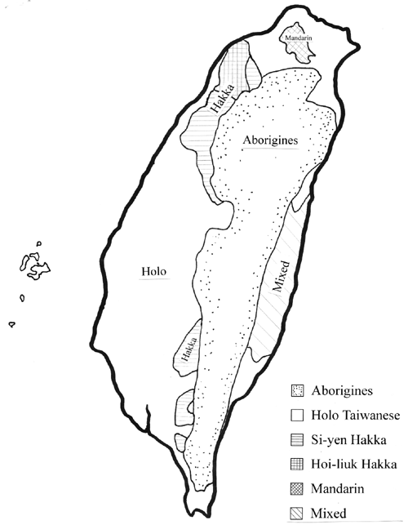
Introduction
The Languages in Taiwan
    Mandarin (about 90%)
      Taipei Mandarin v.s. Beijing Mandarin
      Like American English v.s. British English
      Abundant linguistic resource available
    Taiwanese (about 70%)
      Originated from Min-nan (Southern Min, Hokkien, Amoy, Holo)
      Not much linguistic resource
    Hakka (about 10%)
      Very few linguistic resource
    Most people in Taiwan are bi-lingual or even tri-lingual
Notes:
There exist three languages in Taiwan, including Mandarin, Taiwanese and Hakka. About 90% people use mandarin, but mandarin in Taiwan is not exact like Beijing Mandarin. So, we can say it is Taipei Mandarin. Just like British English versus American English. Almost linguistic resource which we can get is Mandarin. There are about 70% people using Taiwanese. Taiwanese is originated from Min-nan. Somebody say Southern Min, Hokkien, Amoy, Holo instead of Min-nan. It is not much linguistic resource for Taiwanese. Besides Mandarin and Taiwanese, there are 10% people can use Hakka and Hakka linguistic resource is very few. Most people in Taiwan are bi-lingual, even trilingual.

Slide 3
The current status of Taiwanese
Written forms of Taiwanese
  Three main writing schemes of the contemporary Taiwanese
    Full - Han (Chinese) characters
    Full - Roman script
    Mixed Han-Roman
Notes:
It exist three main writing forms of Taiwanese nowadays. First form is full-Han characters, also means full-Chinese characters Second, full-Roman script. Third, Mixed Han-Roman, that means articles include Han character and Roman script.

Slide 4
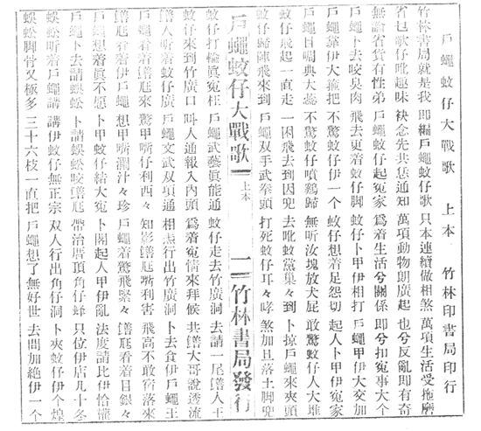
Full-Han (Chinese) characters
Ex
戶蠅蚊仔大戰歌
…
戶蠅靠伊大箍把
不驚蚊仔伊一個
蚊仔想著足怨切
起人卜甲伊冤家
…..
The difficulties of “Han (Chinese) characters only”:
Taiwanese lexicon items can't be well expressed in Han characters.
The existence of various characters for identical words has reduced reading efficiency, and made the readers confused about the meaning of sentences.
Notes:
This is an example of full-Han characters article. But there are two difficulties of “Han characters only”: one, Taiwanese lexicon items can’t be well expressed in Han characters. That is big problem for us to process Taiwanese word in computer. Two, the existence of various characters for identical words has reduced reading efficiency, and made the readers confused about the meaning of sentences. Even though some body knows some Han character, he also can not associate that character with Taiwanese pronunciation or meanings.

Slide 5
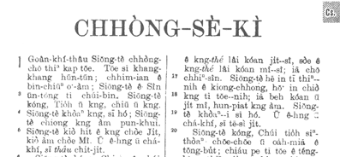
Full-Roman script
Ex
The difficulties of “Full-Roman script”:
No single phonetic transcription system has been accepted by all people till now.
Most Taiwanese are skilled in using Han characters instead of Romanization, texts in full-Roman scripts may reduce their fluency in reading.
Notes:
This transparency shows an example of full-Roman script. But “full-Roman script” also exits some difficulties. Such as no single phonetic transcription system has been accepted by all people till now. That is why Taiwan government starts to discuss a suitable transcription system in Taiwan. The second difficult is that most Taiwanese are skilled in using Han character instead of Romanization; texts in full-Roman scripts may reduce their fluency in reading.

Slide 6
Mixed Han-Roman
Ex
The difficulty of “mixed Han-Roman”:
  Different writers may have different degrees of comprehension of Han characters, the percentage of Roman script used in a text varies from person to person
Generally speaking, the Han-Roman orthography is the most common style for writing Taiwanese in the contemporary Taiwan.
今仔下暗爸爸敢會轉來？氣象報告講zit波冷氣團會di今暗、明仔zai透早降到尚低溫。窗仔外口ｅ樹仔沙沙叫，hit年dui美國cit-tor帶轉來ｅ湯匙仔風鈴kin--kin--kin--響未停。不時窗仔門dor kit-kok-kit-kok leh 搖動，啊，敢會又gorh leh地動啊？倒di眠床頂，我m敢gorh想落去。
Notes:
A piece of mixed Han-Roman article is shown in this slide. Generally speaking, the Han-Roman orthography is the most common style for writing Taiwanese in the contemporary Taiwan. Different writers may have different degrees of comprehension of Han characters, the percentage of Roman script used in a text varies from person to person.

Slide 7

The Issue of Multiple Pronunciations of Taiwanese
Literate (Classical) Pronunciation
  Used in reading classical literature
    “落花流水” pronunced as /lok hua liu sui/
  There exists some correspondence to Mandarin
Oral Pronunciation
  Used in daily lives
    “落花流水” pronunced as /lak hue lau zui/
    Some different dialects exist
    E.g. Taipei, Tai-nan, I-lan, Lu-gang
Notes:
Some Taiwanese words exist at least two pronunciations. Those pronunciations can be categorized into literate pronunciation and oral pronunciation. Literate pronunciations are usually used in reading classical literature and there exists some correspondence to Mandarin. Instead, oral pronunciations are usually used in daily lives and some different dialects exist such as Taipei, Tai-nan, I-Lan and Lu-gang. Now, let to listen what differences in these two pronunciations. In Mandarin, this four-character word is pronounced as “luo hua lio sue”. But in Taiwanese, he has two pronunciations. (play sound)

Slide 8







Taiwanese Text-To-Speech System Overview
Text Module
Bi-lingual
Lexicon
Tone Sandhi rules
Digit sequence processing rules
Phonetic transcription rules
Text analysis
PSOLA waveform synthesis
Text
Prosody Module
Prosody generation
Synthesis
Module
4521 tonal syllable units
Notes:
This is our Taiwanese Text-To-Speech system overview. This system has three main modules: Text analysis module, prosody generation module and PSOLA waveform synthesis module.

Slide 9
The phonetic transcription system (ForPA) for Text analysis module
Taiwanese is a tonal, syllabic language, like the other members of Sino-Tibetan languages.
  17 Consonants for Taiwanese
    b, p, m, bh, d, t, n, l, g, k, ng, gh, h, z, c, s, r
  6 Vowels for Taiwanese
    a, o, er, e, i, u
  5 “Vowel-Modifiers” for Taiwanese
    -nn, -p, -t, -k, -h
  7 lexical tones plus 2 “sandhi derived” tones
Reference: Min-siong Liang, Ren-yuan Lyu and Yuang-chin Chiang, “An efficient algorithm to select phonetically balanced scripts for constructing a speech corpus”, Natural Language Processing and Knowledge Engineering, 26-29 Oct. 2003 Pages:433 - 437
Notes:
Before illustrating text analysis module, the phonetic transcription system should be stated. Basically, Taiwanese is a tonal, syllabic language, like the other members of Sino-Tibetan languages. There are seventeen consonants for Taiwanese, 6 vowels, 5 “vowel-Modifiers” and 7 lexical tones plus 2 “sandhi-derived” tones.

Slide 10


Text analysis module
Sentence to word
  Use the 78,410 word bilingual pronunciation lexicon as the knowledge source
  Apply a word segmentation algorithm based on the sequentially maximal-length matching
Word to phoneme
  Using the oral pronunciation part to transcribe Mandarin word into Taiwanese word
  A example of process of Text analysis module
    Mandarin : 他 今天 心情 很 好
    Taiwanese : 伊 今仔日 心情 真 好
    Transcription : i2 gin2-na1-lit6 sim2-zing2 zin2 her4
Text analysis
Sentence to word
Word to phoneme
Bi-lingual
Lexicon
Digit sequence processing rules
Notes:
In this transparency, the sentence-to-word and word-to-phoneme functions will be explained. We use about seventy-eight thousands word bilingual pronunciation lexicon as the knowledge source and apply sequentially maximal-length matching algorithm to segment sentence into words. In “word-to-phoneme” functions, we use oral pronunciation part to transcribe Mandarin word into Taiwanese word. Take an example to show text analysis module.

Slide 11


Text analysis module (cont.)
The pronunciation of a digit depends on the position of that digit in a sequence
  It can be summarized in rules as follows
  Example 96126431 kilogram
    21435410 kilogram
  The other rule: if digit sequence does not represent a quantity, it is pronounced digit as the classic pronunciation
  Example 96126431
Position | Pronunciation
Ten million | Read 0-9 as oral pronunciation
Million | Read 0-9 as oral pronunciation
Hundred thousand | No sound for 1, 2 as literate pron. and others as oral pron.
Ten thousand | If the digit is 0 in hundred thousand position, read 0-9 as oral pron. If the digit is not 0 in hundred thousand position, 1,2 read as literate pron. and others as oral pron.
Thousand | Read 0-9 as oral pronunciation
Hundred | Read 0-9 as oral pronunciation
Ten | No sound for 1, 2 as literate pron. and others as oral pron.
Unit digit | If the digit is 0 in hundred thousand position, read 0-9 as oral pron. If the digit is not 0 in hundred thousand position, 1,2 read as literate pron. and others as oral pron.
Text analysis
Sentence to word
Word to phoneme
Bi-lingual
Lexicon
Digit sequence processing rules
Notes:
In the addition to non-digit words processing, the digit process in Taiwanese is also an issue. The pronunciation of a digit depends on the position of that digit in a sequence. It can be summarized in following table. In order to show the performance of these rules, two examples are used. Let’s to listen it. The other rule is that if digit sequence does not represent a quantity, it is pronounced digit as the classic pronunciation. It is an example.

Slide 12

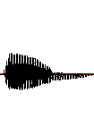





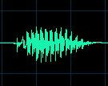







Prosody analysis module
The 9 categories of Taiwanese Tones
Traditionally, there are 7 lexical tones, “8” Low-Stop and “9” High-Rising are necessary for tone-sandhi in our study
ForPA | dong1 | dong2 | dong3 | dong4 | dong5 | dok6 | dok7 | dok8 | dong9
Character | 東 | 洞 | 棟 | 黨 | 同 | 獨 | 督
Waveform
F₀ contour
Notes:
In Taiwanese, there are nine categories of Taiwanese tones. Chinese character is shown in this column, and the relative fundamental frequency contour is shown in this column. Traditionally, there are seven lexical tones in Taiwanese. “8” low-stop and “9” high-rising tone are necessary for tone-sandhi in our study. Here is an example synthesized from our TTS system.

Slide 13


Prosody analysis module (cont.)
The Tone Sandhi Rules
  The tone of that character should usually be changed, when it is embedded in a sentence
  The rule of thumb
    If one character is NOT in the position of the END of a multi-syllabic word, its tone should be changed
  Ex.
    正當(dong1) v.s. 當(dong2)時
    山洞(dong2) v.s. 洞(dong3)口
The rules can be described as follows
Prosody analysis
The rule of thumb
The others rules
5
-p,-t,-k
-h
South
Accent
North Accent
6
7
6
7
1
2
3
4
8
6
3
6
Notes:
Tone-sandhi in Taiwanese is often appeared, when a character is embedded in a sentence. That means tone-sandhi is a big issue in prosody analysis for Taiwanese. The rule of thumb is that “If one character is NOT in the position of the END of a multi-syllabic word, its tone should be changed”. These rules can be described as the following table. First tone should be transformed into second tone, second tone should be transformed into third tone and so on. There are four examples to explain these tone sandhi rules.

Slide 14


Prosody analysis module (cont.)
The other tone sandhi rules for triple character adjectives
Ex.
[Chinese character] [Tone-sandhi result]
紅紅紅 ang9-ang2-ang5
臭臭臭 cau4-cau4-cau3
圓圓圓 inn9-inn2-inn5
Prosody analysis
lexicical | 1 | 2 | 3 | 4 | 5 | 6 | 7
sandhi-tone | 9 | 9 | 4 | 1 | 9 | 9 | 6
The rule of thumb
The others rules
Notes:
The other tone sandhi rules for triple character adjectives. The rule is appeared as this table. Here is an example to present the performance of this rule.

Slide 15
The evaluation of text analysis and prosody module
The evaluation data: abundant articles from internet
The evaluation procedure:
  200 sentences were chosen for manual transcription by two experts.
  Those sentences cover about 41% of all distinct Chinese characters.
Duration | 2002/8/19~2003/5/27
No. of news | 7573
No. of total sentences | 169,040
No. of distinct Chinese character | 4513
The statistics of the selected articles
Notes:
In order to evaluate the performance of text analysis and prosody module, we collect abundant articles from internet and the statistics of these articles is shown as this table. 200 sentences were chosen for manual transcription by two experts. Those sentences cover about 41% of all distinct Chinese characters.

Slide 16
The evaluation of text analysis and prosody module (cont.)
The performance of the text and prosody module
  Compare the automatic transcription with manual transcription
  The comparison is based on a Dynamic Programming-based string alignment procedure
 | Performance (accuracy rate)
Word Segmentation | 98%
Syllable transcription | 88%
Tone transcription | 64%
The statistics of performance in parts of word segment and transfer, labeling and tone-sandhi.
Notes:
After manual transcription, compare the automatic transcription with manual transcription. The comparison is based on a dynamic programming-based string alignment procedure. The following table is presented the statistics of performance in text and prosody modules. The syllable transcription accuracy reach 88%.

Slide 17
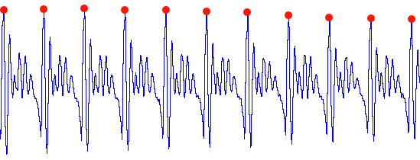
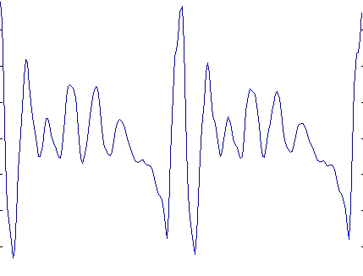
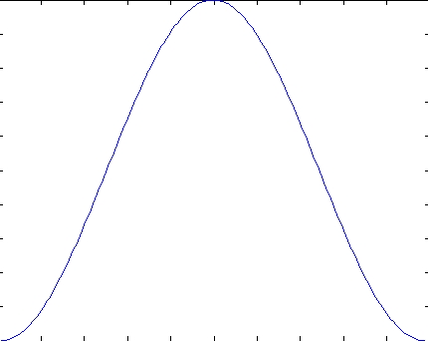
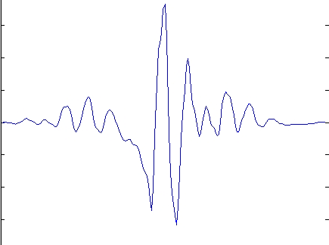
Waveform synthesis module
TD-PSOLA was used to modify the pitch contour of each synthesis unit.
The principles of TD-PSOLA
  Step 1: Find pitch period (1/F₀) and mark the peak of each pitch period
  Step 2: Produce synthesis component
Pitch period
Pitch mark
Waveform piece within two pitch periods
Hanning window
Synthesis Component
*
=
Notes:
In waveform synthesis module, TD-PSOLA method was used to modify the pitch contour of each synthesis unit. The process of TD-PLOSA is finished by two steps. In step 1, we should find pitch period and mark the peak of each pitch period. Step 2: Hanning window multiplied waveform piece within two pitch periods become a synthesis component.

Slide 18
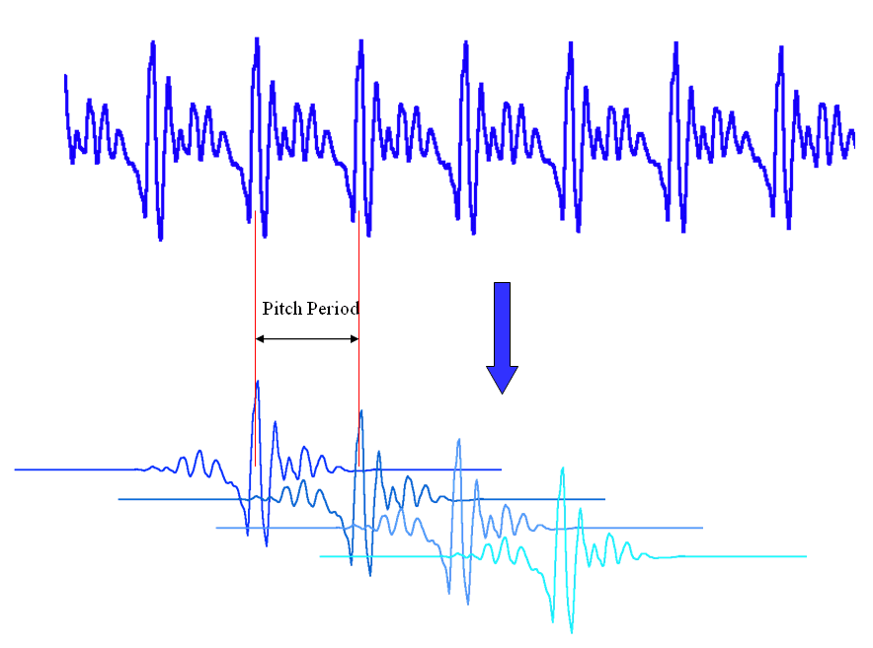
Waveform synthesis module (cont.)
    Adjust the distances between synthesis component to modify pitch period
    Increase or decrease the number of synthesis component to extend or shorten the length of speech
Notes:
Then, adjust the distances between synthesis components to modify pitch period. Similarly, increase or decrease the number of synthesis component to extend or shorten the length of speech like this pitcher.

Slide 19
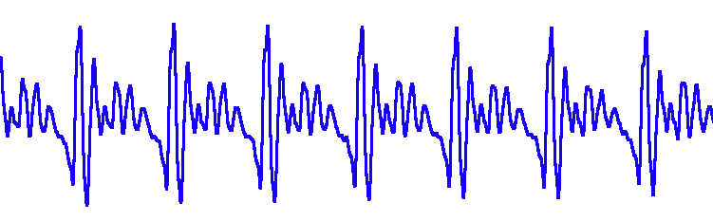
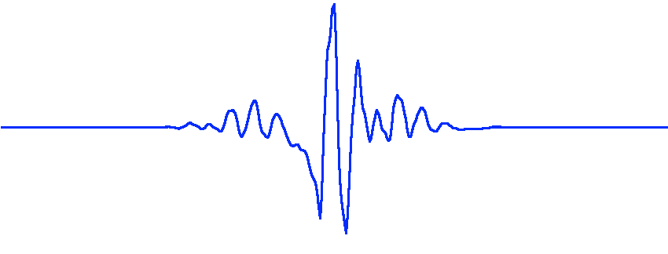
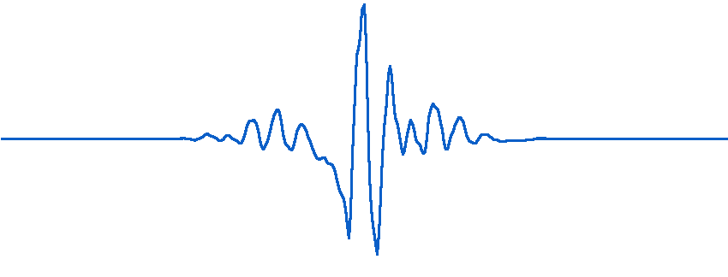
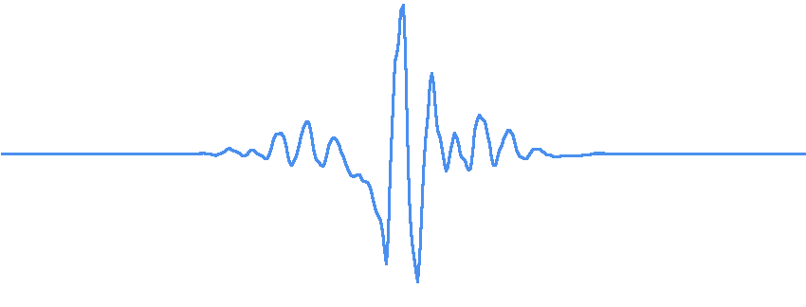
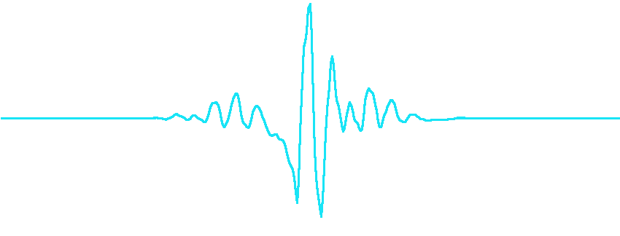
Waveform synthesis module (cont.)
Lower pitch
Rise pitch
Original sound
Increase duration
Shorten duration
Notes:
An example to present result of TD-PSOLA. This is an original sound “a”. Let’s raise pitch and then lower pitch, and increase duration, finally shorten duration.

Slide 20
Taiwanese TTS (FormosaTTS) Demo
A piece of Mandarin article downloaded from internet
  注音符號是專為國語注音使用的符號，所以它並無法完全的表達福佬話、客家語或是原住民語言。
Other TTS system for Mandarin - mulan
Our TTS system for Taiwanese - FormosaTTS
http://ws.twl.ncku.edu.tw/hak-chia/t/tiunn-hakkhiam/lmj-keng-giam.htm
MSRCN Mandarin Text to Speech from https://research.microsoft.com/speech/tts/default.asp
Notes:
This is a piece of Mandarin article downloaded from internet.
This is Microsoft Mandarin TTS result.
Let’s to listen our Taiwanese TTS system result.

Slide 21
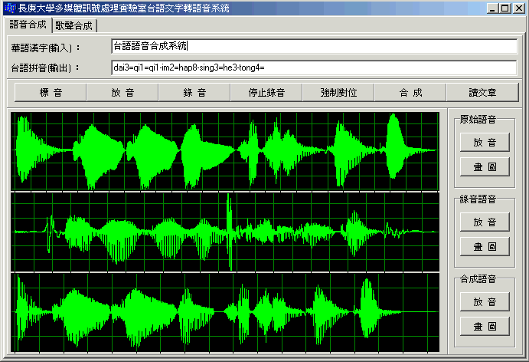
Application to Taiwanese Language Learning
  Taiwanese articles or teaching materials are few in comparison with Mandarin
  It is a better way for Learning Taiwanese that input Mandarin text and output Taiwanese speech
  For this purpose, our Mandarin-to-Taiwanese TTS was created
Notes:
Taiwanese articles or teaching materials are few in comparison with Mandarin. Because we can easily get much Mandarin resource from internet. Therefore, it is a better way for learning Taiwanese that input Mandarin text and output Taiwanese speech by a TTS system. For this purpose, our Mandarin-to-Taiwanese TTS was created. In the preceding slide, our Taiwanese TTS system has been shown.

Slide 22
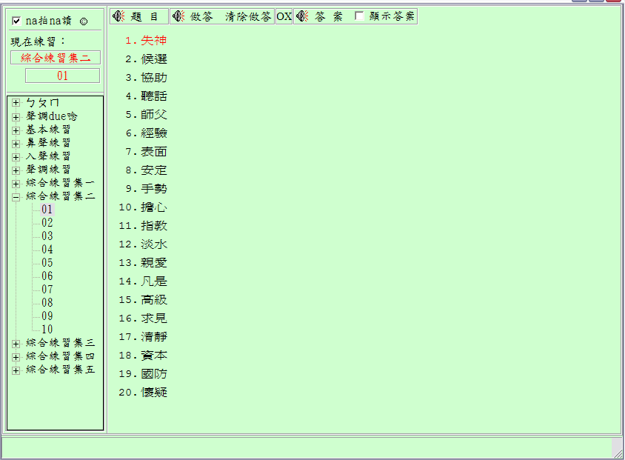
The other Application to Taiwanese Language Learning
  The other better way to learn Taiwanese is to study an appropriate phonetic alphabet
  The system shown below is designed for practicing our phonetic alphabet system (ForPA)
    Feature: This system can sound as we type in ForPA
    We can adjust the transcription until the answer is correct
Notes:
The other better way to learn Taiwanese is to study an appropriate phonetic alphabet. The system shown below is designed for practicing our phonetic alphabet system (ForPA)

Slide 23
Conclusion
We have successfully constructed a Taiwanese TTS system from a bi-lingual lexicon for Taiwanese linguistic learning
This is great helpful for those who want to learn mother-tongue language in Taiwan
In the future
  Enhance tone-sandhi for more accurate speech synthesis, and integrate the TTS system into other applications
  Other languages TTS system will embedded into the TTS system , such as Hakka and Mandarin
Notes:
We have successfully constructed a Taiwanese TTS system from a bi-lingual lexicon for Taiwanese linguistic learning.This is great helpful for those who want to learn mother-tongue language in Taiwan. In the future, Enhance tone-sandhi for more accurate speech synthesis, and integrate the TTS system into other applications. Other languages TTS system will embedded into the TTS system , such as Hakka and Mandarin

